Slide 1
OPERATING SYSTEMS(21CS44) Module 2

Slide 2
Basic Concepts
CPU Scheduling
CPU scheduling is the basis of multiprogramming OS.
By switching the CPU among processes, the OS can make the computer more productive.
In a single processor system, only one process can run at a time.
Any other must wait until the CPU is free and can be rescheduled.
The objective of multiprogramming is to have some process running at all times, to maximize CPU utilization.
A process is executed until it must wait, typically for the completion of some I/O request.
In a simple computer system, the CPU then just sits idle.
All the waiting time is wasted, no useful work is accomplished.
With multiprogramming, we try to use this time productively.
Dept. of AI&ML

Slide 3
Several processes are kept in memory at one time.
When one process has to wait the OS takes the CPU away from that process and gives the CPU to another process and the pattern continues.
Dept. of AI&ML

Slide 4
CPU and I/O Burst Cycles
Process execution consists of a cycle of CPU execution and I/0 wait.
Processes alternating between these two states.
Process execution begins with a
CPU burst. That is followed by an
I/O burst, which is followed by another
CPU burst, then another
I/0 burst,
and so on.
CPU burst is when the process is being executed in the CPU.
I/O burst is when the CPU is waiting for I/O for further execution.
Dept. of AI&ML

Slide 5
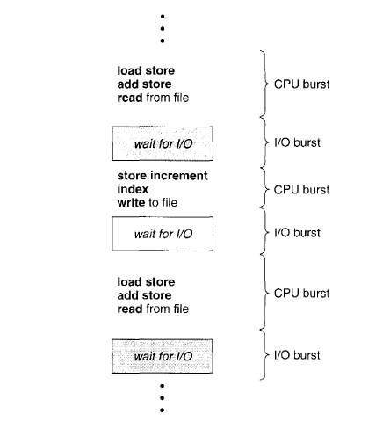
Eventually, the final CPU burst ends with a system request to terminate execution
Dept. of AI&ML
Alternating sequences of CPU and I/O bursts.

Slide 6
Preemptive and Non-Preemptive Scheduling
CPU Scheduler
Whenever the CPU becomes idle, the operating system must select one of the processes in the ready queue to be executed. The selection process is carried out by the short-term scheduler (CPU scheduler). The scheduler selects a process from the processes in memory that are ready to execute and allocates the CPU to that process.
Dispatcher
The dispatcher is the module that gives control of the CPU to the process selected by the CPU scheduler.
The time it takes for the dispatcher to stop one process and start another running is known as the dispatch latency.
Dept. of AI&ML

Slide 7
CPU-scheduling decisions may take place under the following four circumstances:
When a process switches from the running state to the waiting state.
When a process switches from the running state to the ready state(for ex. When interrupt occurs)
When a process switches from the waiting state to the ready state.(for ex.at completion of I/O)
When a process terminates.
For situation 1 and 4, there is no choice in terms of scheduling.
A new process(if one exits in the ready queue) must be selected for execution.
However, there is a choice for situation 2 and 3.
When scheduling takes place only under circumstances 1 and 4, we say that the scheduling scheme is nonpreemptive or cooperative, otherwAI&ML, it is preemptive.
Dept. of AI&ML

Slide 8
Scheduling Criteria
Different CPU-scheduling algorithms have different properties, and the choice of a particular algorithm may favor one class of processes over another. In choosing which algorithm to use in a particular situation, we must consider the properties of the various algorithms.
The criteria include the following:
CPU utilization: We want to keep the CPU as busy as possible. Conceptually, CPU utilization can range from 0 to 100 percent. In a real system, it should range from 40 percent(for a lightly loaded system) to 90 percent( for a heavily used system).
Throughput: If the CPU is busy executing processes, then work is being done. One measure of work is the number of processes that are completed per time unit, called throughput.
Dept. of AI&ML

Slide 9
Turnaround Time (TAT): Form the point of view of a particular process, the important criteria is how long it takes to execute that process. The interval from the time of submission of a process to the time of completion is the turnaround time. Turnaround time is the sum of the periods spent waiting to get into memory, waiting in the ready queue, executing on the CPU, and doing I/O.
Waiting time: The CPU scheduling algorithm does not affect the amount of time during which a process executes or does I/O;it affects only the amount of time that a process spends waiting in the ready queue. Waiting time is the sum of the periods spent waiting in the ready queue.
Dept. of AI&ML

Slide 10
Response time: In an interactive system, turnaround time may not be the best criteria. Often, a process can produce some output fairly early and can continue computing new results while previous results are being output to the user. Thus, another measure is the time from the submission of a request until the first response is produced. This measure, called response time, is the time it takes to start responding, not the time it takes to output the response. The turnaround time is limited by the speed of the output device.
It is desirable to maximize CPU utilization and throughput and to minimize turnaround time, waiting time, and response time.
Dept. of AI&ML

Slide 11
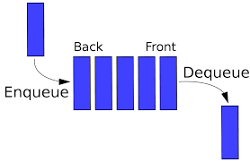
Scheduling Algorithms
First-Come, First-Served Scheduling (FCFS)
This is the simplest scheduling algorithm.
The process that requests the CPU first is allocated the CPU first.
The implementation of the FCFS scheduling is easily managed with a FIFO queue.
When a process enters the ready queue, its PCB is linked onto the tail of the queue.
When the CPU is free, it is allocated to the process at the head of the queue.
The running process is then removed from the queue.
The advantage of this algorithm is simple, it easy to write and understand the code.
The drawback is the average waiting time under the FCFS policy is quite long.
Dept. of AI&ML

Slide 12
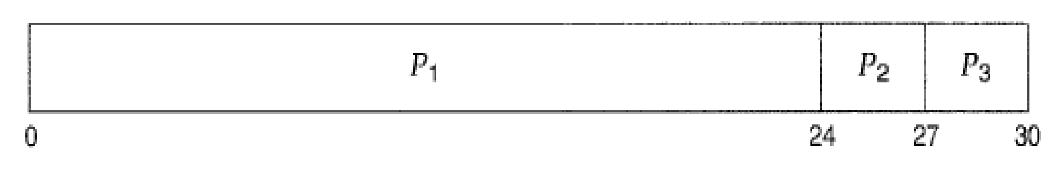
Consider the following set of processes that arrive at time 0, with the length of the CPU burst given in millAI&MLconds
CPU bursts in millAI&MLconds
Process | Burst time
P1 | 24
P2 | 3
P3 | 3
If the processes arrive in the order P₁, P₂, P₃, and are served in FCFS order. Then the scheduling is as follows. The process scheduling can be illustrated with a bar chart called Gantt chart which illustrates a particular scheduling algorithm, with the start and finish times of each of the participating processes: the Gantt chart is shown below:
Dept. of AI&ML
Gantt chart

Slide 13
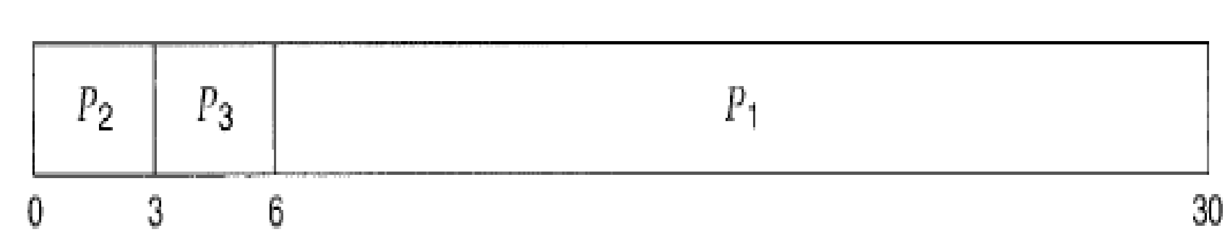
Waiting time for P₁ = 0; P₂ = 24; P₃ = 27
Average waiting time: (0 + 24 + 27)/3 = 17ms
In the previous problem if the processes arrive in the order: P₂, P₃, P₁ then the scheduling is as follows:
Dept. of AI&ML
Waiting times
Waiting time for P₁ = 6; P₂ = 0; P₃ = 3
Average waiting time: (6 + 0 + 3)/3 = 3ms

Slide 14
This reduction is substantial. Thus. The average waiting time under an FCFS policy is generally not minimal and may vary substantially if the process ‘s CPU burst times vary greatly.
The FCFS scheduling algorithm is nonpreemptive.
Once the CPU has been allocated to a process, that process keeps the CPU until it releases the CPU, either by terminating or by requesting I/O.
The PCFS algorithm is thus particularly troublesome for time-sharing systems, where it is important that each user get a share of the CPU at regular intervals.
It would be disastrous to allow one process to keep the CPU for an extended period.
Convoy effect: If the process with higher burst time arrived before the process with smaller burst time then smaller processes have to wait for a long time for larger processes to release CPU.
Dept. of AI&ML

Slide 15
Shortest-Job-First Scheduling (SJFS)
A different approach to CPU scheduling is the shortest-job-first (SJF) scheduling algorithm.
This algorithm associates with each process the length of the process's next CPU burst.
When the CPU is available, it is assigned to the process that has the smallest next CPU burst.
If the next CPU bursts of two processes are the same, FCFS scheduling is used to break the tie.
The SJF algorithm can be either preemptive and non preemptive
Dept. of AI&ML

Slide 16
A more appropriate term for this scheduling method would be the Shortest – Next - CPU - Burst Algorithm because scheduling depends on the length of the next CPU burst of a process, rather than its total length.
Dept. of AI&ML

Slide 17
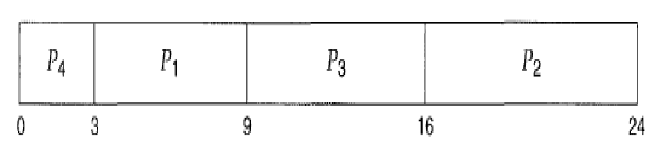
Example of SJF Scheduling (Non – Preemptive)
Consider the following set of processes, with the length of the CPU burst given in millAI&MLconds
Process | Burst Time
P1 | 6
P2 | 8
P3 | 7
P4 | 3
Dept. of AI&ML

Slide 18
Waiting Time: P₁=3; P₂=16; P₃=9; P4=0.
Average waiting time = (3 + 16 + 9 + 0) / 4 = 7
By comparison, if we were using the FCFS scheduling scheme, the average waiting time would be 10.25 millAI&MLconds.
Dept. of AI&ML

Slide 19
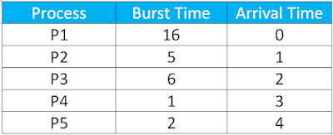
Example of SRTF Scheduling (Preemptive)
In Preemptive SJF Scheduling, jobs are put into the ready queue as they come.
A process with shortest burst time begins execution.
If a process with even a shorter burst time arrives, the current process is removed or preempted from execution, and the shorter job is allocated CPU cycle.
Dept. of AI&ML

Slide 20
One approach is
To try to approximate SJF scheduling.
We may not know the length of the next CPU burst, but we may be able to predict its value.
We expect that the next CPU burst will be similar in length to the previous one.
Thus, by computing an approximation of the length of the next CPU burst, we can pick the process with the shortest predicted CPU burst.
Dept. of AI&ML

Slide 21
Priority Scheduling
A priority is associated with each process, and the CPU is allocated to the process with the highest priority.
Equal-priority processes are scheduled in FCFS order.
An SJF algorithm is simply a priority algorithm where the priority (p) is the inverse of the (predicted) next CPU burst.
The larger the CPU burst, the lower the priority, and vice versa.
A priority Scheduling can be either preemptive or nonpreemptive.
When a process arrives at the ready queue, its priority is compared with the priority of the currently running process.
Dept. of AI&ML

Slide 22
A Preemptive priority scheduling algorithm will pre-empt the CPU if the priority of the newly arrived process is higher than the priority of the currently running process.
A non-preemptive priority scheduling algorithm will simply put the new process at the head of the ready queue.
A major problem with priority scheduling algorithm is indefinite blocking.
A process that is ready to run but waiting for the CPU can be considered blocked.
A priority scheduling algorithm can leave some low priority processes waiting indefinitely.
Dept. of AI&ML

Slide 23
In a heavily loaded computer system, a steady stream of higher priority processes can prevent a low priority process from ever getting the CPU.
A solution to the problem of indefinite blockage of low-priority processes is aging.
Aging is a technique of gradually increasing the priority of processes that wait in the system for a long time.
For example,
If priority range from 127 (low) to 0 (high), we could increase the priority of a waiting process by 1 every 15mins.
Eventually, even a process with an initial priority of 127 would have the highest priority in the system and would be executed.

Slide 24

EX: Consider the following set of processes, assumed to have arrived at time 0 in the orderP₁, P₂, · · ·, P₅, with the length of the CPU burst given in millAI&MLconds:
Process | Burst Time | Priority
P1 | 10 | 3
P2 | 1 | 1
P3 | 2 | 4
P4 | 1 | 5
P5 | 5 | 2
The waiting time is: P1=6; P2=0; P3=16; P4=18; P5=1.
The average waiting time = (6+0+16+18+1)/5=8.2 msec.

Slide 25
Round-Robin Scheduling
The round-robin (RR) scheduling algorithm is designed especially for timesharing systems.
It is similar to FCFS scheduling, but preemption is added to enable the system to switch between processes.
A small unit of time, called a time quantum or time slice, is defined.
The ready queue is treated as a circular queue.
The CPU scheduler goes around the ready queue, allocating the CPU to each process for a time interval of up to 1 time quantum.

Slide 26
To implement RR scheduling
we keep the ready queue as a FIFO queue of processes.
New processes are added to the tail of the ready queue.
The CPU scheduler picks the first process from the ready queue, sets a timer to interrupt after 1 time quantum, and dispatches the process.
One of two things will then happen.
The process may have a CPU burst of less than 1 time quantum.
The process itself will release the CPU voluntarily
The CPU scheduler will then proceed to the next process in the ready queue

Slide 27
The CPU burst of the currently running process is longer than 1 time quantum, the timer will go off and will cause an interrupt to the operating system.
A context switch will be executed, and the process will be put at the tail of the ready queue.
The CPU scheduler will then select the next process in the ready queue.
The average waiting time under the RR policy is often long.
In the RR scheduling algorithm, no process is allocated the CPU for more than 1 time quantum in a row. The performance of the RR algorithm depends heavily on the size of the time quantum.

Slide 28
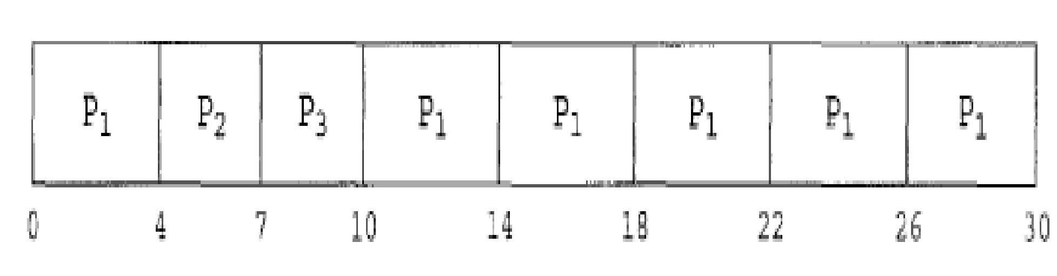
Ex: Consider the following set of processes that arrive at time 0, with the length of the
CPU burst given in millAI&MLconds with time quantum of 4ms.
Process | Burst Time
P1 | 24
P2 | 3
P3 | 3
The waiting time: P₁=6; P₂=4; P₃=7.
Average Waiting Time=(6+4+7)/3= 5.66 ms
Dept. of AI&ML

Slide 29
Multilevel Queue Scheduling
A class of scheduling algorithms has been created for situations in which processes are easily classified into different groups.
Example:
A common division is made between foreground (interactive) processes and background (batch) processes. These two types of processes have different response time requirements and so may have different scheduling needs.
In addition, foreground processes may have priority (externally defined) over background processes.
A multilevel queue scheduling algorithm partitions the ready queue into several separate queues .
Dept. of AI&ML

Slide 30
The processes are permanently assigned to one queue, generally based on some property of the process, such as memory size, process priority, or process type.
Each queue has its own scheduling algorithm.
Example
Separate queues might be used for foreground and background processes.
The foreground queue might be scheduled by an RR algorithm, while the background queue is scheduled by an FCFS algorithm.
In addition, there must be scheduling among the queues, which is commonly implemented as fixed – priority preemptive scheduling.
For example, the foreground queue may have absolute priority over the background queue.
Dept. of AI&ML

Slide 31
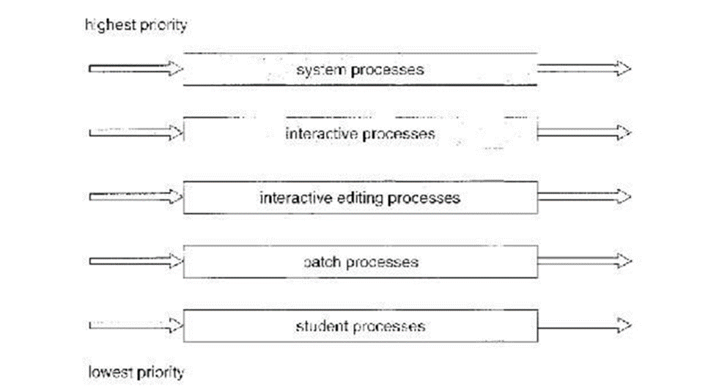
An example of multilevel queue scheduling algorithm with five queues, listed below in order of priority.
Dept. of AI&ML
Multilevel queue scheduling

Slide 32
Multilevel Feedback Queue Scheduling
The multilevel feedback queue scheduling algorithm allows a process to move between queues.
The idea is to separate processes according to the characteristics of their CPU bursts.
If a process uses too much CPU time, it will be moved to a lower-priority queue.
This scheme leaves I/O-bound and interactive processes in the higher-priority queues.
In addition, a process that waits too long in a lower-priority queue may be moved to a higher priority queue.
This form of aging prevents starvation.
Dept. of AI&ML

Slide 33
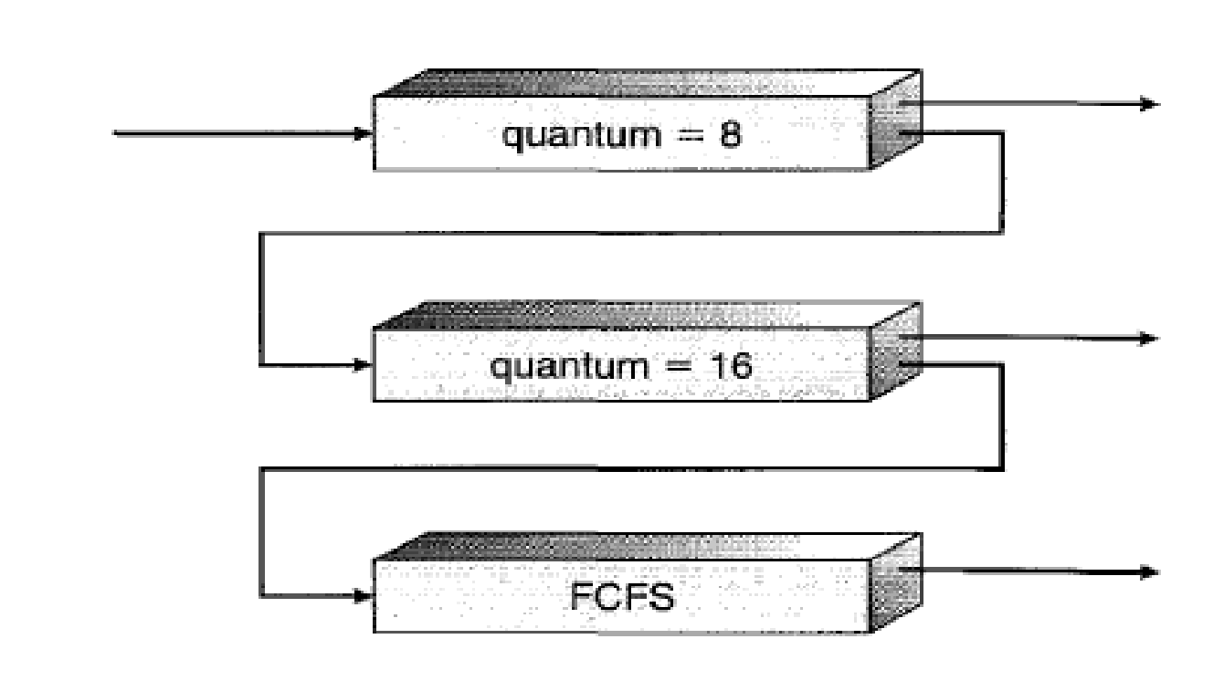
Dept. of AI&ML
Multilevel feedback queues.

Slide 34
In general, a multilevel feedback-queue scheduler is defined by the following parameters:
The number of queues.
The scheduling algorithm for each queue.
The method used to determine when to upgrade a process to a higher priority queue.
The method to determine when to demote a process to a lower priority queue.
The method used to determine which queue a process will enter when that process needs service.
Dept. of AI&ML

Slide 35
Multiple-Processor Scheduling
If multiple CPUs are available, load sharing becomes possible; however, the scheduling problem becomes correspondingly more complex.
Many possibilities have been tried; and as we saw with single processor CPU scheduling, there is no one best solution.
The processes which are in ready queue may be migrated.
Dept. of AI&ML

Slide 36
Approaches to Multiple-Processor Scheduling
There are two approaches in multiple processor scheduling.
1.Asymmetric Multiprocessing
When the scheduling decisions and I/O processing are handled by a single processor which is called master server and other processors executes only the user code.
This is simple and reduces the need of data sharing.
This entire scenario is called Asymmetric multiprocessing
Master
Master
Master
Master
Dept. of AI&ML
No shared memory
P1
P2
P3
P4

Slide 37
2.Symmetric Multiprocessing
All the processes may be in common ready queue or each processor may have its own private queue for ready processes. The scheduling proceeds by having the scheduler for each processer examine the ready queue and select process

Slide 38
Processor Affinity
If the process migrates to another processor: The contents of cache memory must be invalidated for the processor being migrated from, and the cache for the processor being migrated to must be re-populated.
Because of the high cost of invalidating and re-populating caches, most SMP systems try to avoid migration of processes from one processor to another and instead attempt to keep a process running on the same processor.
This is known as processor affinity, meaning that a process has an affinity for the processor on which it is currently running.

Slide 39
Load Balancing
On SMP systems, it is important to keep the workload balanced among all processors to fully utilize the benefits of having more than one processor.
OtherwAI&ML, one or more processors may sit idle while other processors have high workloads along with lists of processes awaiting the CPU.
Load balancing attempts to keep the workload evenly distributed across all processors in an SMP system
Load balancing is necessary only on systems where each processor has its own private queue of process which are eligible to execute.

Slide 40
Module 2
Chapter 2: Multi-threaded Programming:

Slide 41
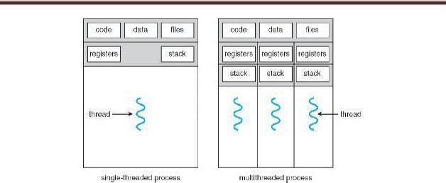
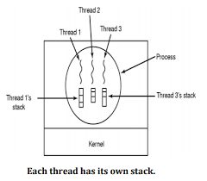
THREADS
A thread is a basic unit of CPU utilization.
It consists of a thread ID, a program counter, a register set, and a stack.
It shares with other threads belonging to the same process its code section, data section, and other operating-system resources.
If a process has multiple threads of control, it can perform more than one task at a time.
Below Figure illustrates the difference between a single threaded process and a multi-threaded process.
Dept. of AI&ML
Single threaded and Multi-threaded processes

Slide 42
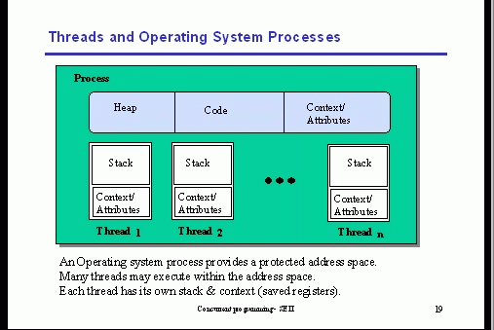
Dept. of AI&ML

Slide 43
Benefits of Multithreaded Programming:
Responsiveness: In Multithreading an interactive application may allow a program to continue running even if part of it is blocked or is performing a lengthy operation, thereby increasing responsiveness to the user.
Resource sharing: Processes may only share resources through shared memory or message passing. These techniques must be explicitly arranged by the programmer. But, threads share the memory and the resources of the process to which they belong by default. The benefit of sharing code and data is that it allows an application to have several different threads of activity within the same address space.
Economy: Allocating memory and resources for process creation is costly. Because threads share the resources of the process to which they belong, it is more economical to create and context-switch threads. It is much more time consuming to create and manage processes than threads.
Dept. of AI&ML

Slide 44
Scalability: A single-threaded process can only run on one processor, regardless how many are available. Multithreading on a multiprocessor machine that increases parallelism.
Utilization of multiprocessor architectures: The benefits of multithreading can be greatly increased in a multiprocessor architecture, where threads may be running in parallel on different processors. A single threaded process can only run on one CPU, no matter how many are available. Multithreading on a multi CPU machine increases concurrency.
Dept. of AI&ML

Slide 45
Types of threads
User threads – Supported above the kernel and are managed without kernel support.
Kernel threads – Supported and managed directly by OS.
There must be relationship between user threads and kernel threads.
There are three common ways of establishing relationship:
Many-to-One Model
One-to-One Model
Many-to-Many Model
Dept. of AI&ML

Slide 46
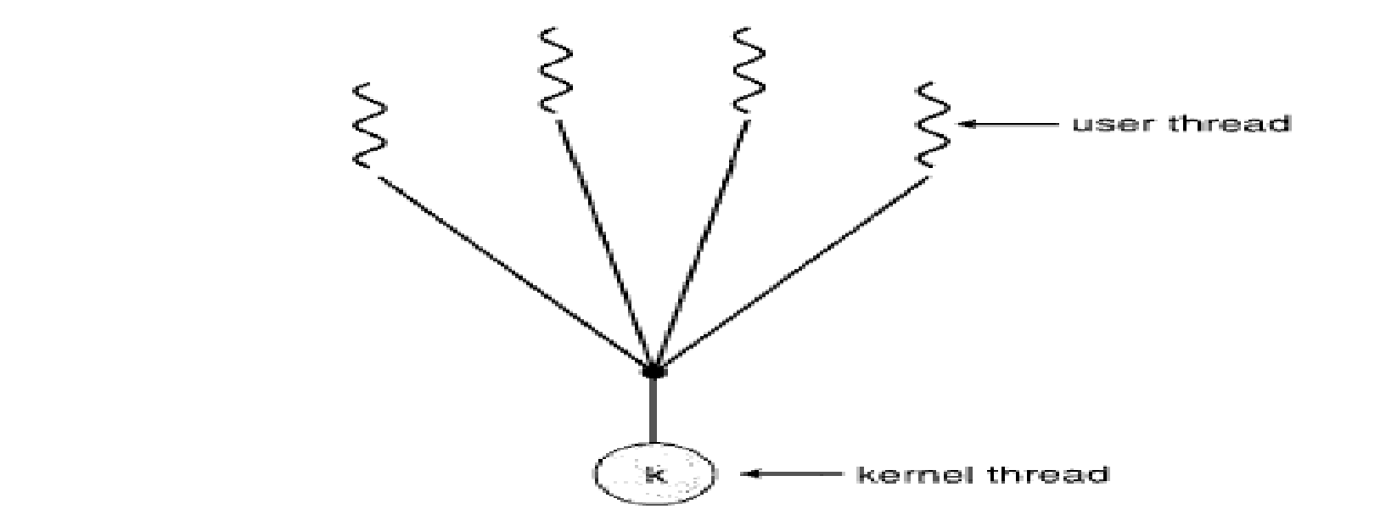
Multithreading Models
Many-to-One Model
Maps many user-level threads to one kernel thread.
Thread management is done by the thread library in user space, so it is efficient.
The entire process will block if a thread makes a blocking system call.
Because only one thread can access the kernel at a time, multiple threads are unable to run in parallel on multiprocessors.
Dept. of AI&ML

Slide 47
One-to-One Model
Maps each user thread to a kernel thread.
Provides more concurrency than the many-to-one model by allowing another thread to run when a thread makes a blocking system call;
Also allows multiple threads to run in parallel on multiprocessors.
Creating a user thread requires creating the corresponding kernel thread.
Because the overhead of creating kernel threads can burden the performance of an application, most implementations of this model restrict the number of threads supported by the system.
Dept. of AI&ML

Slide 48
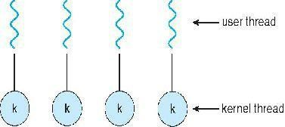
Dept. of AI&ML

Slide 49
Many-to-Many Model
Maps many user-level threads to a smaller or equal number of kernel threads.
The number of kernel threads may be specific to either a particular application or a particular machine.
Developers can create as many user threads as necessary, and the corresponding kernel threads can run in parallel on a multiprocessor.
Also, when a thread performs a blocking system call, the kernel can schedule another thread for execution.
Dept. of AI&ML

Slide 50
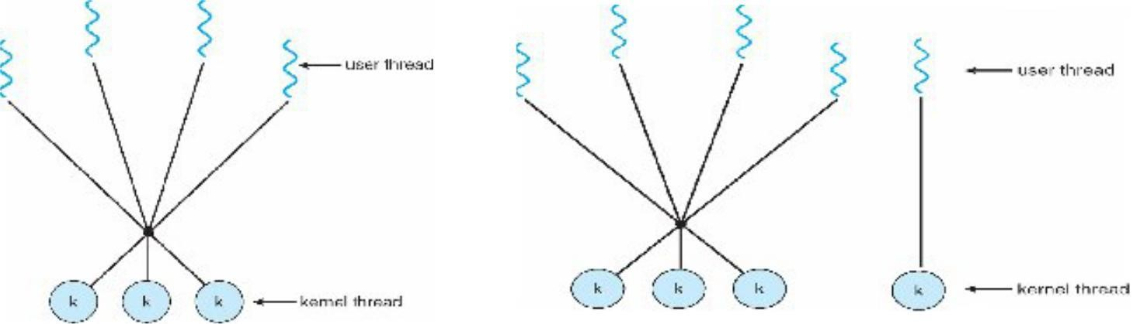
Dept. of AI&ML

Slide 51
Thread Libraries
A thread library provides the programmer with an API for creating and managing threads. There are two ways for implementing a thread library.
The first approach is to provide a library entirely in user space with no kernel support.
All code and data structures for the library exist in user space.
i.e invoking a function in the library results in a local function call in user space and not a system call.
The second approach is to provide a kernel-level library supported directly by the operating system.
All code and data structures for the library exist in kernel space.
i.e. invoking a function in the API for the library results in a system call to the kernel.
Dept. of AI&ML

Slide 52
The main thread libraries
POSIX threads: The library includes pthreads.h header file.
The POSIX thread provided as either a user level or a kernel level library.
Win32 library is similar to pthread library.
To create a thread using the Win32 library always include windows.h header file in the program.
The windows thread library is s kernel level library available on windows systems.
JAVA thread The JAVA thread API allows threads to be created and managed directly as JAVA programs.
Dept. of AI&ML

Slide 53
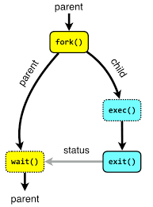
Threading Issues
Fork() : if one thread in program calls fork() , all threads are duplicated or one thread is duplicated.
exec(): if one thread invokes exec() the program with specified in the parameter to exec() will replace the entire process including all threads.
Dept. of AI&ML

Slide 54
Thread Cancellation
Thread cancellation is the task of terminating a thread before it has completed.
If multiple threads are concurrently searching through a database and one thread returns the result, the remaining threads might be cancelled.
When a user press a button on a web browser that stops a web page from loading any further, all threads loading the page are canceled.
A thread that is to be cancelled is often referred to as the Target thread.
Cancellation of a target thread may occur in two different scenarios:
Asynchronous Cancellation: One thread immediately terminates the target thread.
Dept. of AI&ML

Slide 55
Deferred cancellation: The target thread periodically checks whether it should terminate, allowing it an opportunity to terminate itself in an orderly fashion.
Where the difficulty with cancellation lies:
In the situation where
Resources have been allocated to a canceled thread.
A thread is canceled while in the midst of updating data it is sharing with other threads.
Often, the OS will reclaim system resources from a canceled thread but will not reclaim all resources.
Therefore, cancelling a thread asynchronously may not free a necessary system wide resources.
Dept. of AI&ML

Slide 56
With deferred cancellation: One thread indicates that a target thread is to be canceled.
But cancellation occurs only after the target thread has checked a flag to determine if it should be canceled or not.
This allows a thread to check whether it should be canceled at a point when it can be canceled safely.
Dept. of AI&ML

Slide 57
Signal Handling
A signal is used in UNIX systems to notify a process that a particular event has occurred. A signal may be received either synchronously or asynchronously, depending on the source of and the reason for the event being signaled. All signals follow the same pattern:
A signal is generated by the occurrence of a particular event.
A generated signal is delivered to a process. Once delivered, the signal must be handled.
Synchronous signals are delivered to the same process that performed the operation that caused the signal.
Ex: Illegal memory access, division by zero.
Asynchronous signal is generated by an event external to a running process, that process receives the signal asynchronously.
Dept. of AI&ML

Slide 58
A signal may be handled by one of two possible handlers:
A default signal handler
A user-defined signal handler
Every signal has a default signal handler that is run by the kernel when handling that signal.
This default action can be overridden by a user defined signal handler that is called to handle the signal.
Dept. of AI&ML

Slide 59
In single-threaded programs signals are always delivered to a process. However, delivering signals is more complicated in multithreaded programs, where a process may have several threads.
Where, then, should a signal be delivered? So following options will exist:
Deliver the signal to the thread to which the signal applies.
Deliver the signal to every thread in the process.
Deliver the signal to certain threads in the process.
Assign a specific thread to receive all signals for the process.
Dept. of AI&ML

Slide 60
The method for delivering a signal depends on the type of signal generated.
Synchronous signals need to be delivered to the thread causing the signal and not to other threads in the process.
In asynchronous signals is not as clear and should be sent to all threads.
Dept. of AI&ML

Slide 61
Thread Pools:
In a Web server, whenever the server receives a request, it creates a separate thread to service the request. There is some amount of time required to create the thread prior to servicing the request, after completing service this thread will be discarded. If we allow all concurrent requests to be serviced in a new thread, we have not placed a bound on the number of threads concurrently active in the system. Unlimited threads could exhaust system resources. So the solution to this problem is to use a Thread pool.
Dept. of AI&ML

Slide 62
Thread Pools:
In a thread pool we create a number of threads at process startup and place them into a pool, where they sit and wait for work. When a server receives a request, it awakens a thread from this pool-if one is available and passes it the request for service.
Dept. of AI&ML

Slide 63
Once the thread completes its service, it returns to the pool and awaits more work. If the pool contains no available thread, the server waits until one becomes free.
The advantages of thread pool are:
Servicing a request with an existing thread is usually faster than waiting to create a thread.
A thread pool limits the number of threads that exist at any one point. This is important on systems that cannot support a large number of concurrent threads.
Dept. of AI&ML

Slide 64
Thread-Specific Data
Threads belonging to a process share the data of the process. This sharing of data provides one of the benefits of multithreaded programming. But in some circumstances, each thread need its own copy of certain data. We will call such data as thread–specific data.
Scheduler Activations:
In many-to-many multithreaded model communication between the kernel and the thread library is required. This communication allows the number of kernel threads to be dynamically adjusted to help ensure the best performance.
Dept. of AI&ML
Dept. of AI&ML

Slide 65
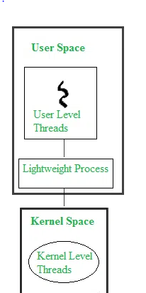
Systems implementing many to-many model place an intermediate data structure between the user and kernel threads. This data structure-typically known as a lightweight process (LWP) is shown in Figure.
To the user-thread library, the LWP appears to be a virtual processor on which the application can schedule a user thread to run. Each LWP is attached to a kernel thread, and it is kernel threads that the operating system schedules to run on physical processors.
If a kernel thread blocks, such as while waiting for an I/0 operations to complete the LWP blocks as well. Up the chain, the user-level thread attached to the LWP also blocks.
Dept. of AI&ML

Slide 66
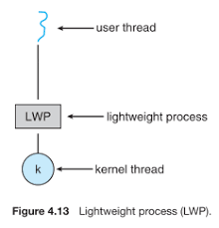
Light Weight Process (LWP)
Communication between the user-thread library and the kernel is known as scheduler activation. Scheduler activation works as follows:
Dept. of AI&ML
The kernel must inform an application about certain events. This procedure is known as an Upcalls are handled by the thread library with an Upcall handler and upcall handlers must run on a virtual processor.

Slide 68
Process Synchronization
• Co-operating process is one that can affect or be affected by other processes executing.
• Co-operating processes can either
directly share a logical address-space (i.e. code & data)
Or be allowed to share data only through files or messages.
• Concurrent-access to shared-data may result in data-inconsistency.
To maintain data-consistency, the orderly execution of co-operating processes is necessary.

Slide 69
Producer consumer Problem
A producer process produces information that is consumed by a consumer process.
For example, a complier may produce assembly code, which is consumed by an assembler. The assembler ,in turn , may produce object modules, which are consumed by the loader.
One solution to the producer – consumer problem uses shared memory.
To allow produces and consumer processes to run concurrently, we must have available a buffer of items that can be filled by the producer and emptied by the consumer.
This buffer will reside in a region of memory that is shared by the producer and consumer processes.

Slide 70
A producer can produce one item while the consumer is consuming another item.
The producer and consumer must be synchronized, so that the consumer does not try to consume an item that has not yet been produced.
Two types of buffers can be used.
The unbounded buffer places no practical limit on the size of the buffer. The consumer may have to wait for new items, but the producer can always produce new items.
The bounded buffer assumes a fixed buffer size. In this case, the consumer must wait if the buffer is empty, and the producer must wait if the buffer is full.

Slide 71
Counter variable = 0
Counter is incremented every time we add a new item to the buffer. Counter++
Counter is decremented every time we remove one item from the buffer. Counter—
Ex: Suppose that the value of the variable counter is currently 5
The producer and consumer processes execute the statements "counter++" and "counter--" concurrently.
Following the execution of these two statements, the value of the variable counter may be 4, 5, or 6!
The only correct result, though, is counter == 5, which is generated correctly if the producer and consumer execute separately.

Slide 72
“Counter++ may be implemented in machine language as:
register₁ = counter
register₁ = register₁ + 1
counter = register₁
“Counter-- may be implemented in machine language as:
register₂ = counter
register₂ = register₂ - 1
counter = register₂
T₀ : | producer | execute | register₁ = counter | {register₁ = 5}
T₁ : | producer | execute | register₁ = register₁ + 1 | {register₁ = 6}
T₂ : | consumer | execute | counter = register₁ | {register₂ = 5}
T₃ : | consumer | execute | register₂ = counter | {register₂ = 4}
T₄ : | producer | execute | register₂ = register₂ - 1 | {counter = 6}
T₅ : | consumer | execute | counter = register₂ | {counter = 4}

Slide 73
We would arrive at this incorrect state because we allowed boths processes to manipulate the variable counter concurrently.
A situation like this, where several processes access and manipulate the same data concurrently and the outcome of the execution depends on the particular order in which the access takes place, is called a race condition.
Clearly, we want the resulting changes not to interfere with one counter. Hence we need process synchronization.

Slide 74
The Critical-Section Problem
Consider a system consisting of 11 processes {Po, P1, ... , P_{n-1}}.
Each process has a segment of code, called a
critical section
in which the process may be changing common variables, updating a table, writing a file, and so on.
When one process is executing in its critical section, no other process is to be allowed to execute in its critical section.
That is, no two processes are executing in their critical sections at the same time.
The critical-section problem is to design a protocol that the processes can use to cooperate.

Slide 75
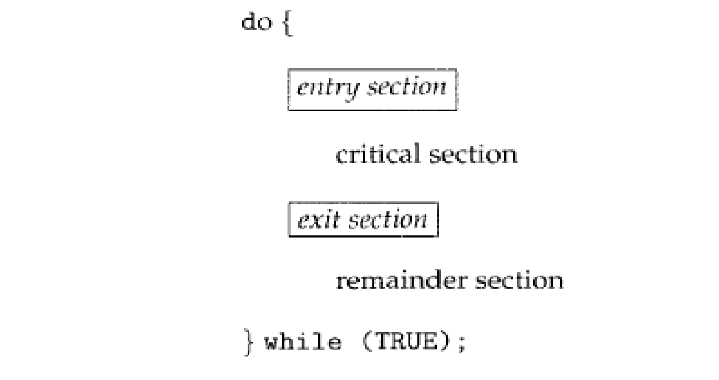
Each process must request permission to enter its critical section.
The section of code implementing this request is the entry section.
The critical section may be followed by an exit section.
The remaining code is the remainder section.
General structure of a typical process p_{i}

Slide 76
A solution to the critical-section problem must satisfy the following three requirements:
Mutual exclusion. If process Pi is executing in its critical section, then no other processes can be executing in their critical sections.
Progress. If no process is executing in its critical section and some processes wish to enter their critical sections, then only those processes that are not executing in their remainder sections can participate in the decision on which will enter its critical section next, and this selection cannot be postponed indefinitely.
Bounded waiting. There exists a bound, or limit, on the number of times that other processes are allowed to enter their critical sections after a process has made a request to enter its critical section and before that request is granted.

Slide 77
Peterson's Solution
A classic software-based solution to the critical-section problem.
May not work correctly on modern computer architecture.
However, it provides a good algorithmic description of solving the critical-section problem and illustrates some of the complexities involved in designing software that addresses the requirements of mutual exclusion, progress/ and bounded waiting requirements.
Peterson’s solution is restricted to two processes that processes that alternate execution between their critical section and remainder section. Let’s call the processes P_{i} and P_{j}
Peterson’s solution requires two data items to be shared between two processes:

Slide 78
int turn;
boolean flag [2];
The variable turn indicates whose turn it is to enter its critical section.
That is, if turn == i, then process Pi is allowed to execute in its critical section.
The flag array is used to indicate if a process is ready to enter its critical section.
For example, if flag [i] is true, this value indicates that Pi is ready to enter its critical section.

Slide 79
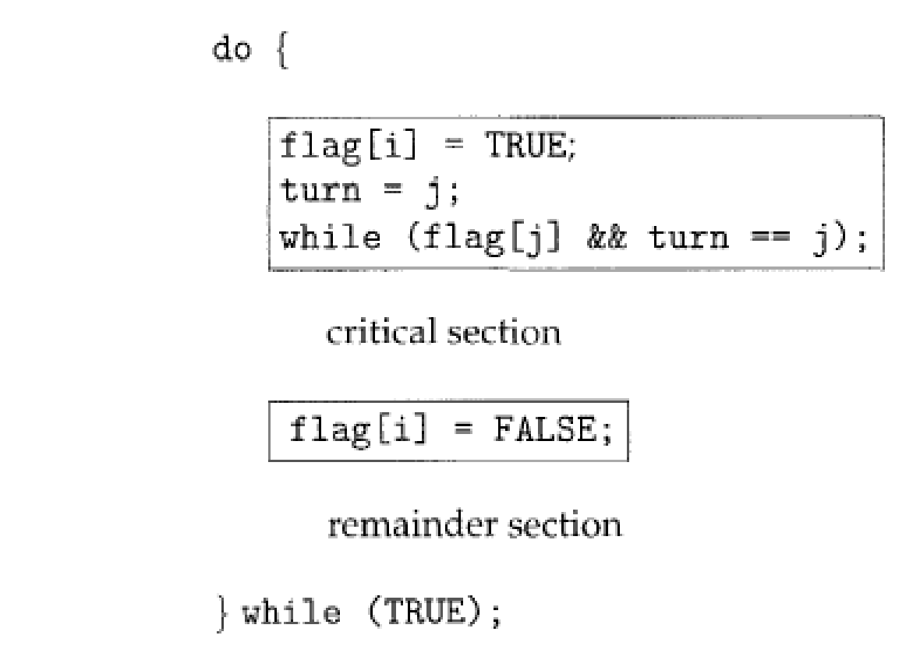
Structure of process P_{j} in Peterson’s solution
do {
flag[j] = true;
turn = i;
while(flag[i] && turn == i);
critical section
flag[j] = false;
Remainder section
} while(True);
The structure of process P_{i} in Peterson’s solution

Slide 80
To enter the critical-section,
Firstly process Pi sets flag [i] to be true and
Then sets turn to the value j.
If both processes try to enter at the same time, turn will be set to both i and j at roughly the same time.
The final value of turn determines which of the 2 processes is allowed to enter its critical-section first. To prove that this solution is correct, we show that:
Mutual-exclusion is preserved.
The progress requirement is satisfied.
The bounded-waiting requirement is met

Slide 81
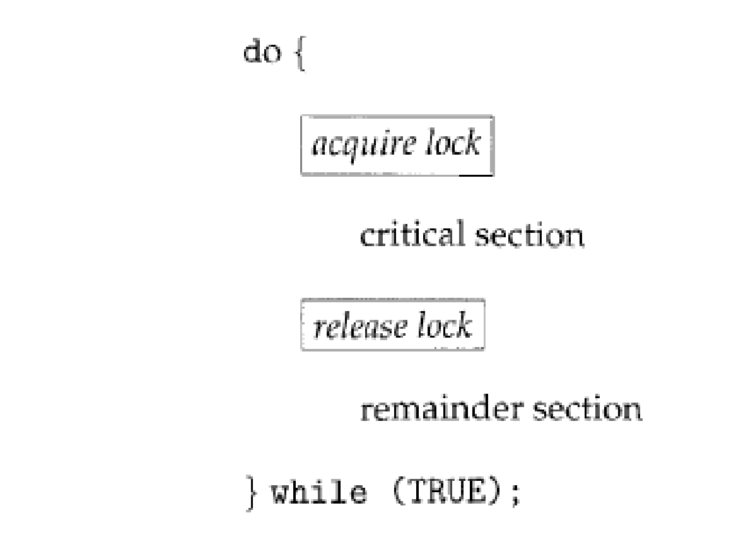
Test and Set Lock: A hardware solution to the synchronization.
There is a shared lock variable which can take either of two values, 0 or 1.
Before entering into the critical section, a process inquires about the lock.
If it is locked, it keeps on waiting till it becomes free.
If it is not locked, it takes the lock and executes the critical section.
boolean TestAndSet (boolean *target) {
boolean rv = *target;
*target = TRUE;
return rv;
}
Definition of the Test AndSet () instruction.
Solution to the critical section problem using locks.

Slide 82
do {
while (TestAndSetLock(&lock))
; //do nothing
//critical section
lock = FALSE;
//remainder section
}while (TRUE);
Satisfies mutual exclusion
Does not satisfy bounded waiting

Slide 83
Semaphores
Semaphore is simply a variable which is non negative and shared between threads. This variable is used to solve the critical section problem and to achieve process synchronization in multiprocessing
A semaphore S is an integer variable that, apart from initialization, is accessed only through two standard atomic operations: wait () and signal ().
The wait () operation was originally termed P (from the Dutch proberen, "to test")
Signal() was originally called V (from verhagen, "to increment").
The definition of wait () is as follows:

Slide 84
wait (S) {
while S <= 0
;
S--;
}
The definition of signal () is as follows:
signal (S) {
S++;
}

Slide 85
All the modifications to the integer value of the semaphore in the wait() and signal() operations must be executed indivisibly. That is, when one process modifies the semaphore value, no other process can simultaneously modify that same semaphore value.
Types of semaphores
Binary semaphores
The value of a binary semaphore can range only between 0 and 1. On some systems, binary semaphores are known as mutex locks, as they are locks that provide mutual exclusion.
2. Counting semaphores
The value of a counting semaphore can range over an unrestricted domain. It is used to control access to a resource that has multiple instances.

Slide 86
Disadvantages of Semaphores
The main disadvantage of the semaphore definition given here is that it requires busy waiting.
While a process is in its critical section, any other process that tries to enter its critical section must loop continuously in the entry code.
Busy waiting wastes CPU cycles that some other process might be able to use productively.
This type of semaphore is also called a spinlock because the process "spins" while waiting for the lock.

Slide 87
To overcome the need for busy waiting, we can modify the definition of the wait () and signal () semaphore operations.
When a process executes the wait () operation and finds that the semaphore value is not positive, it must wait.
However, rather than engaging in busy waiting, the process can block itself.
The block operation places a process into a waiting queue associated with the semaphore, and the state of the process is switched to the waiting state.
Then control is transferred to the CPU scheduler, which selects another process to execute.

Slide 88
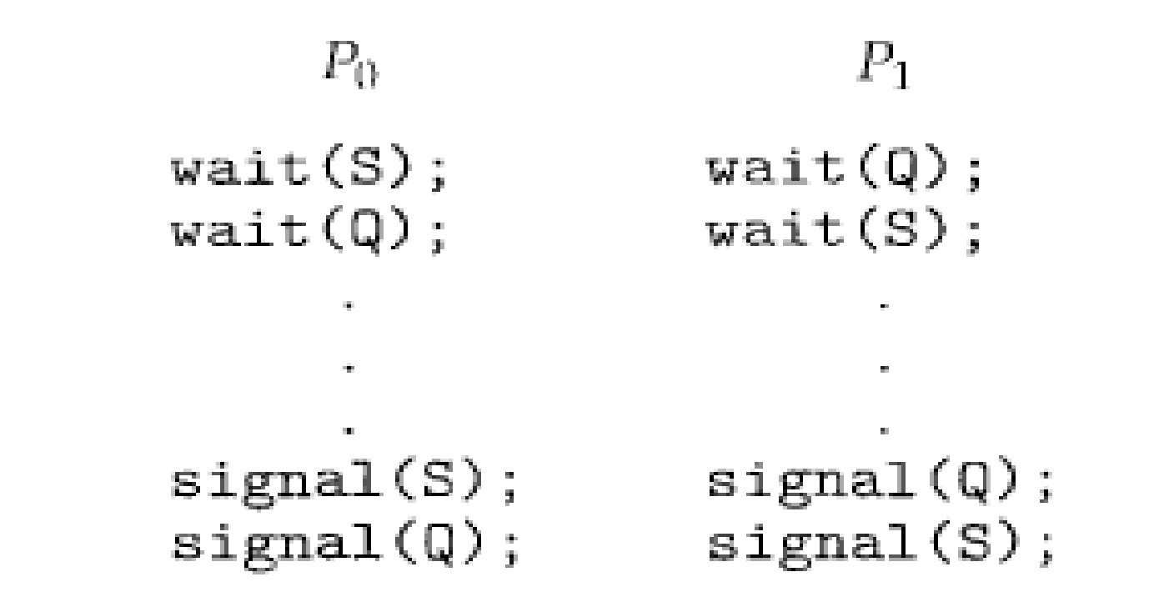
Deadlocks and Starvation
The implementation of a semaphore with a waiting queue may result in a situation where two or more processes are waiting indefinitely for an event that can be caused only by one of the waiting processes.
The event in question is the execution of a signal 0 operation. When such a state is reached, these processes are said to be deadlocked.

Slide 89
Classic Problems of Synchronization
The Bounded-Buffer Problem
The bounded buffer problem is one of the classic problems of synchronization.
There is a buffer of n slots and each slot is capable of staring one unit of data.
There are two processes running ,namely, producer and consumer, which are operating on the buffer.
The producer tries to insert data into an empty slot of the buffer.
The consumer tries to remove data from a filled slot in the buffer.
The producer must not insert data when the buffer is full.
The consumer must not remove data when the buffer is empty.
The producer and consumer should not insert and remove data simultaneously.

Slide 90
Solution to the Bounded Buffer Problem using semaphores
We will make use of 3 semaphores
m(mutex), a binary semaphore which is used to acquire and release the lock.
Empty, a counting semaphore whose initial value is the number of slots in the buffer, since, initially all slots are empty.
Full, a counting semaphore whose initial value is 0

Slide 91
Structure of Producer process
do{
wait(empty); // wait until empty > 0 and then decrement ‘empty’
wait(mutex); //acquire lock
//add data to buffer//
signal(mutex); //release lock
signal(full); // increment ‘full’
} while(True)
Structure of Consumer process
do{
wait(full); // wait until full> 0 and then decrement ‘full’
wait(mutex); //acquire lock
//remove data from buffer//
signal(mutex); //release lock
signal(empty); // increment ‘empty’
} while(True)

Slide 92
The Readers-Writers Problem
A database is to be shared among several concurrent processes.
Some of these processes may want only to read the database, whereas others may want to update (that is, to read and write) the database.
We distinguish between these two types of processes by referring to the former as readers and to the latter as writers.
Obviously, if two readers access the shared data simultaneously, no adverse effects will result.
However, if a writer and some other thread (either a reader or a writer) access the database simultaneously, chaos may ensue.

Slide 93
To ensure that these difficulties do not arAI&ML, we require that the writers have exclusive access to the shared database.
This synchronous problem is referred to as the readers – writers problem.
Solution to the readers – writers problem using semaphores
We will make use of two semaphores and an integer variable.
mutex, a semaphore(initialized to 1) which is used to ensure mutual exclusion when the variable readcount is updated, that is when any reader enters or exit from the critical section.
wrt, a semaphore (initialized to 1) common to both reader and writer processes.
readcount, an integer variable (initialized to 0) that keeps track of how many processes are currently reading the object.

Slide 94
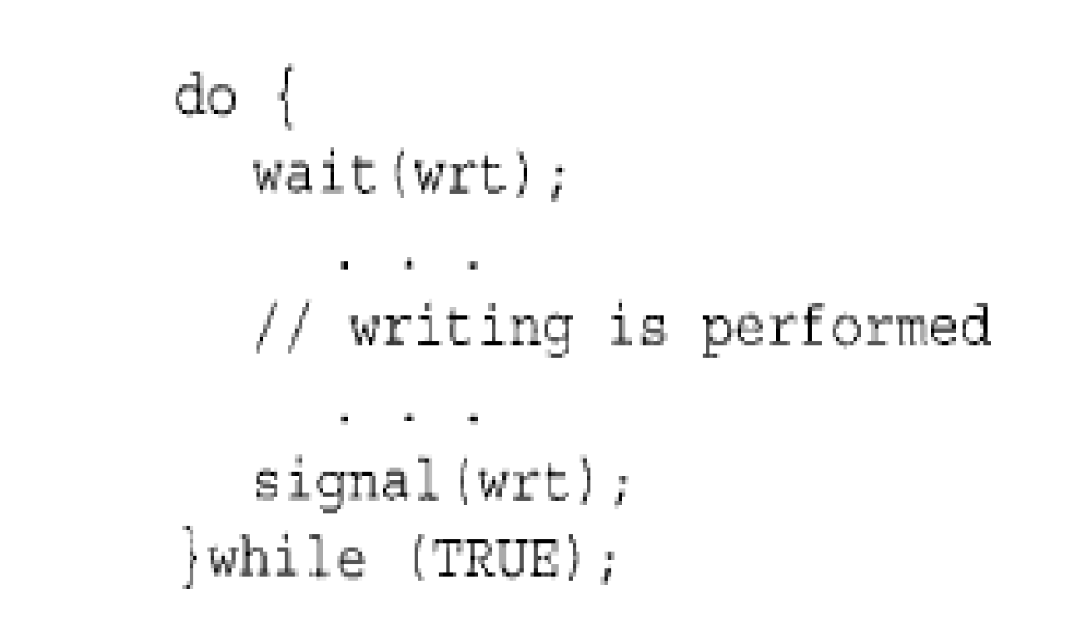
Writer requests to the critical section
Performs the write
Leaves the critical section
The structure of writer process.

Slide 95
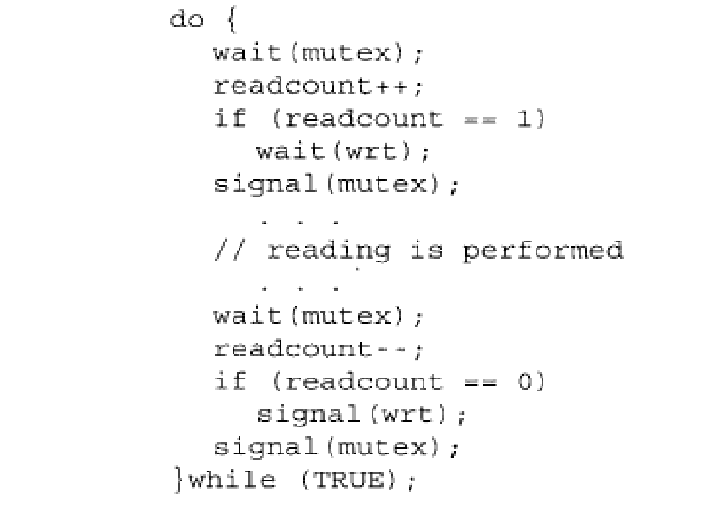
The number of readers is increased by 1
This ensures no writer can enter if there is even one reader
Other readers can enter while this current reader is inside the critical section
Current reader performs reading here
A reader wants to leave
No reader is left in the critical section
Writers can enter
Reader leaves
The structure of writer process.

Slide 96
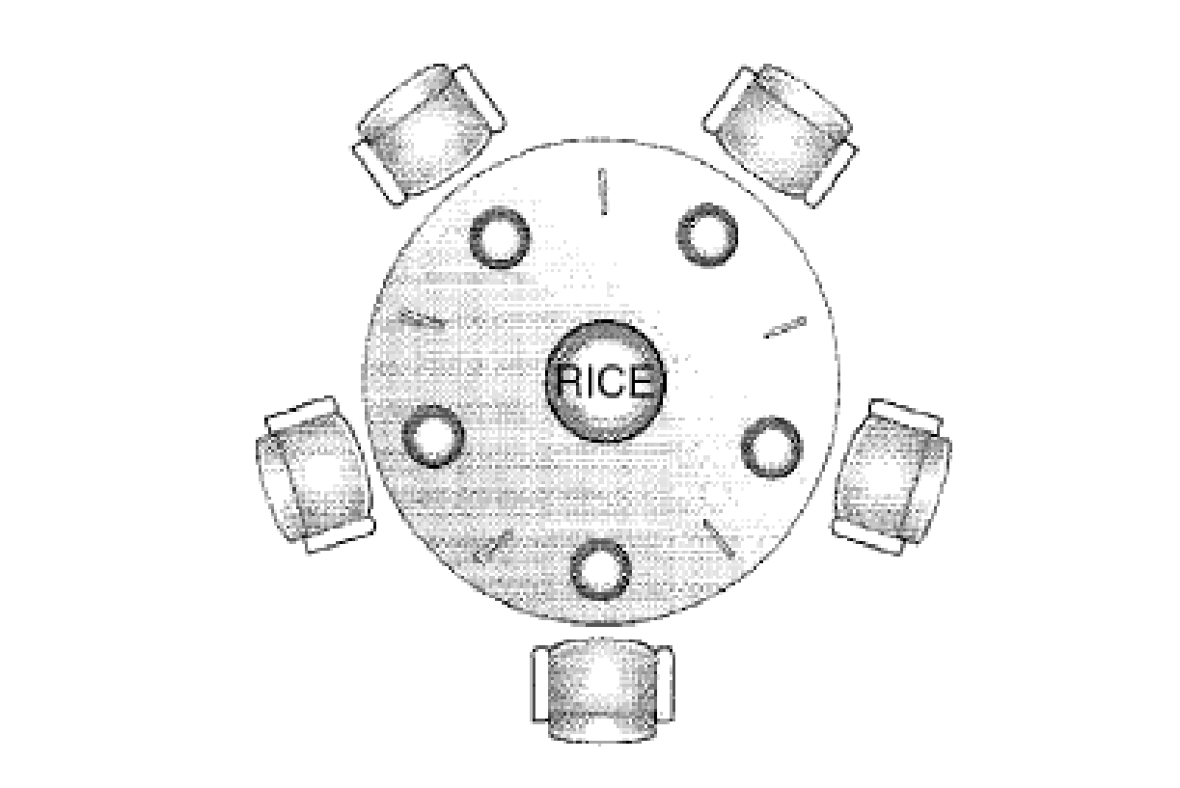
The Dining-Philosophers Problem
The situation of dining philosophers.

Slide 97
Philosopher either thinks or eats
Thinks
When a philosopher thinks, he does not interact with his colleagues.
Eats
When a philosopher gets hungry he tries to pick up the two forks that are closet to him (left or right). A philosopher may pick up only one fork at a time.
One cannot pick up a fork that is already in the hand of a neighbour.
When a hungry philosopher has both his forks at the same time, he eats without releasing his forks.
When he has finished eating, he puts down both of his forks and starts thinking again.

Slide 98
One simple solution is to represent each chopstick/fork with a semaphore.
A philosopher tries to grab a chopstick by executing a wait () operation on that semaphore.
She releases her chopsticks/fork by executing the signal () operation on the appropriate semaphores.
Thus, the shared data are
semaphore chopstick [5];
Where all the elements are fork are initialized to 1.

Slide 99
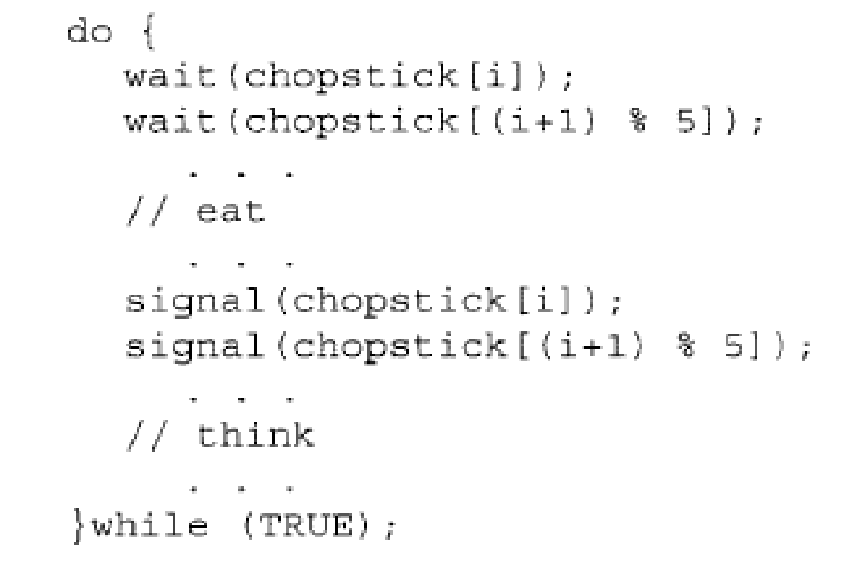
The structure of philosophers i

Slide 100
Although this solution guarantees that no two neighbors are eating simultaneously, it nevertheless must be rejected because it could create a deadlock.
Suppose that all five philosophers become hungry simultaneously and each grabs her left chopstick. All the elements of chopstick will now be equal to 0.
When each philosopher tries to grab her right chopstick, she will be delayed forever.
Some possible remedies to avoid deadlocks.
Allow at most four philosophers to be sitting simultaneously at the table.
Allow a philosopher to pick up her chopsticks only if both chopsticks are available
Use an asymmetric solution; that is, an odd philosopher picks up first her left chopstick and then her right chopstick, whereas an even philosopher picks up her right chopstick and then her left chopstick.

Slide 101
Monitors
A high level abstraction that provides a convenient and effective mechanism for process synchronization.
A monitor type presents a set of programmer – defined operations that provide mutual exclusion within the monitor.
The monitor type also contains the declaration of variables whose values define the state of an instance of that type, along with the bodies of procedures or functions that operate on those variables.

Slide 102
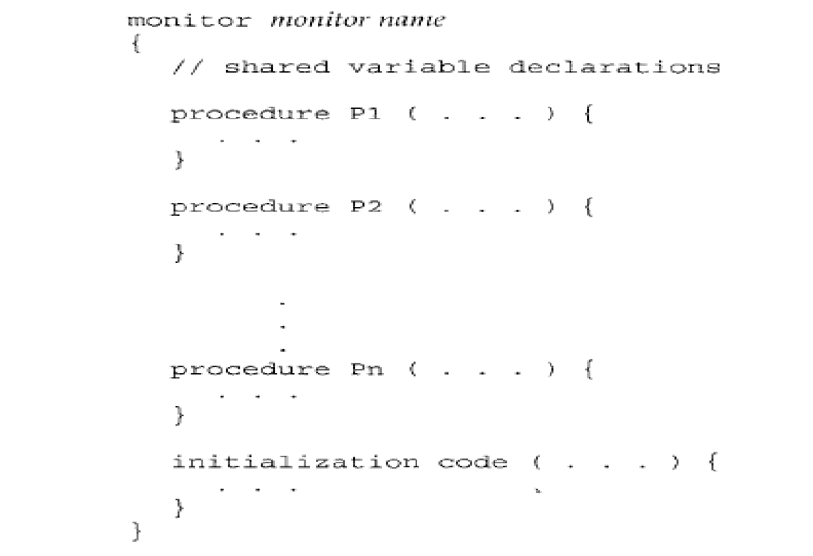
Syntax of a monitor

Slide 103
A procedure defined within a monitor can access only those variables declared locally within the monitor and its formal-parameters.
Similarly, the local-variables of a monitor can be accessed by only the local-procedures.
The monitor construct ensures that only one process at a time can be active within the monitor.
Condition construct: condition x,y;
The only operations that can be invoked on a condition variable are wait() and signal()
The operation x.wait(); means that the process invoking this operation is suspended until other process invokes x.signal(),
The x.signal() operation resumes exactly one suspended process.

Slide 104
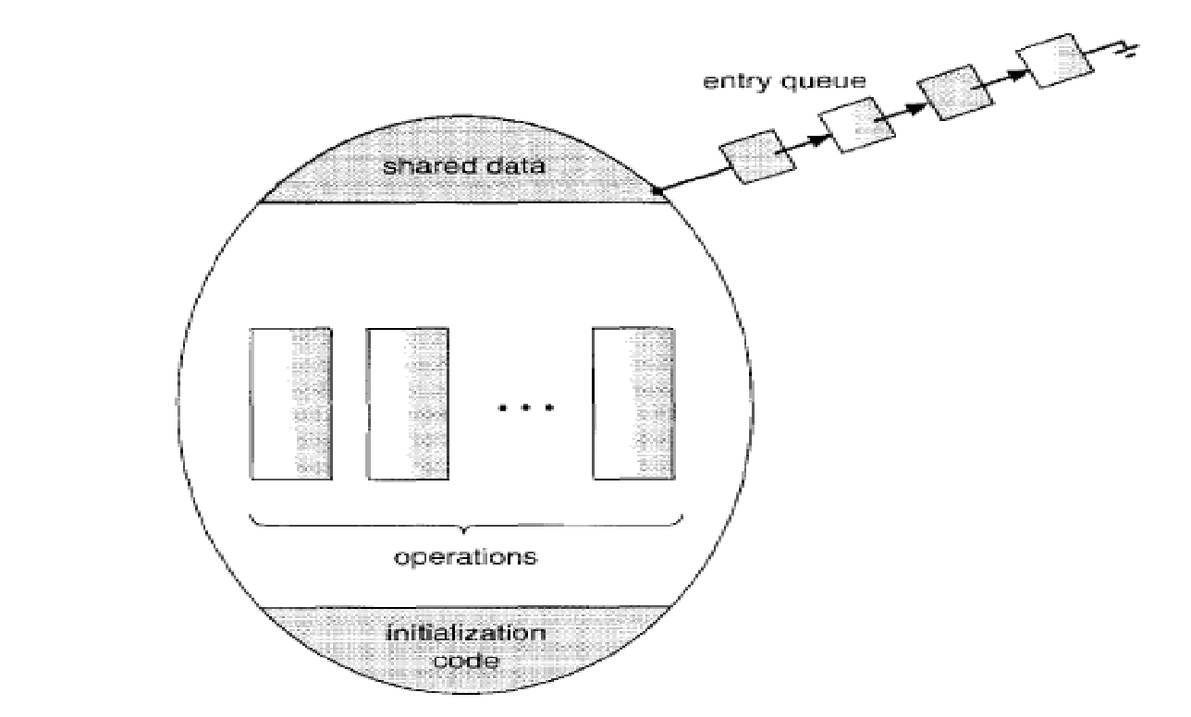
Schematic view of a monitor

Slide 105
Dining-Philosophers Solution Using Monitors
We now illustrate monitor concepts by presenting a deadlock-free solution to the dining-philosophers problem.
This solution imposes the restriction that a philosopher may pick up her chopsticks only if both of them are available.
To code this solution, we need to distinguish among three states in which we may find a philosopher. For this purpose, we introduced the following data structure.
enum{thinking, hungry, eating} state [5] ;
Philosopher i can set the variable state[i] = eating only if her two neighbors are not eating(state[(i+4) %5] != eating)and(state[(i+1) %5] ! = eating).

Slide 106
We also need to declare
condition self [5] ;
where philosopher i can delay herself when she is hungry but is unable to obtain the chopsticks she needs.

Slide 107
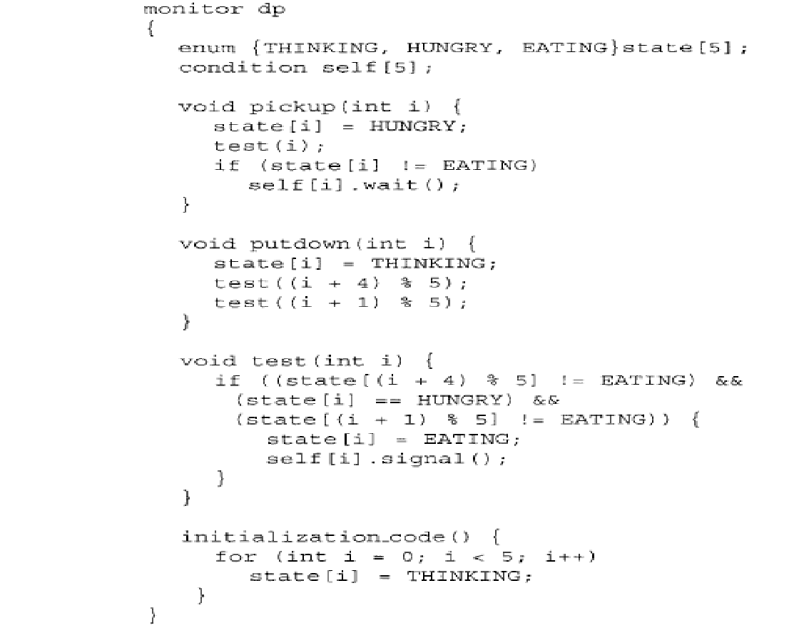
A monitor solution to dining philosopher problem

